Slide 1

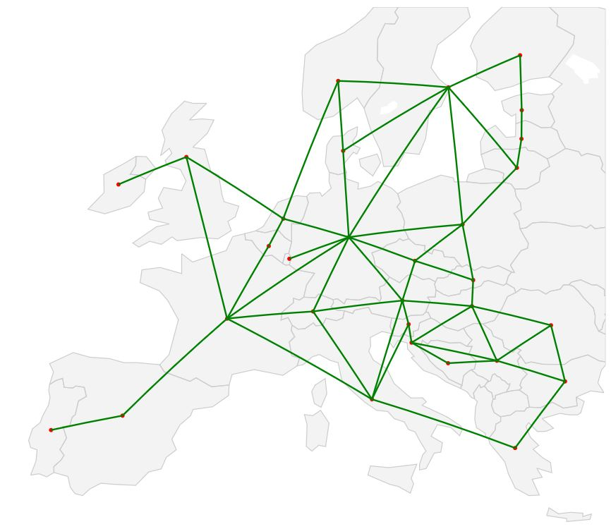


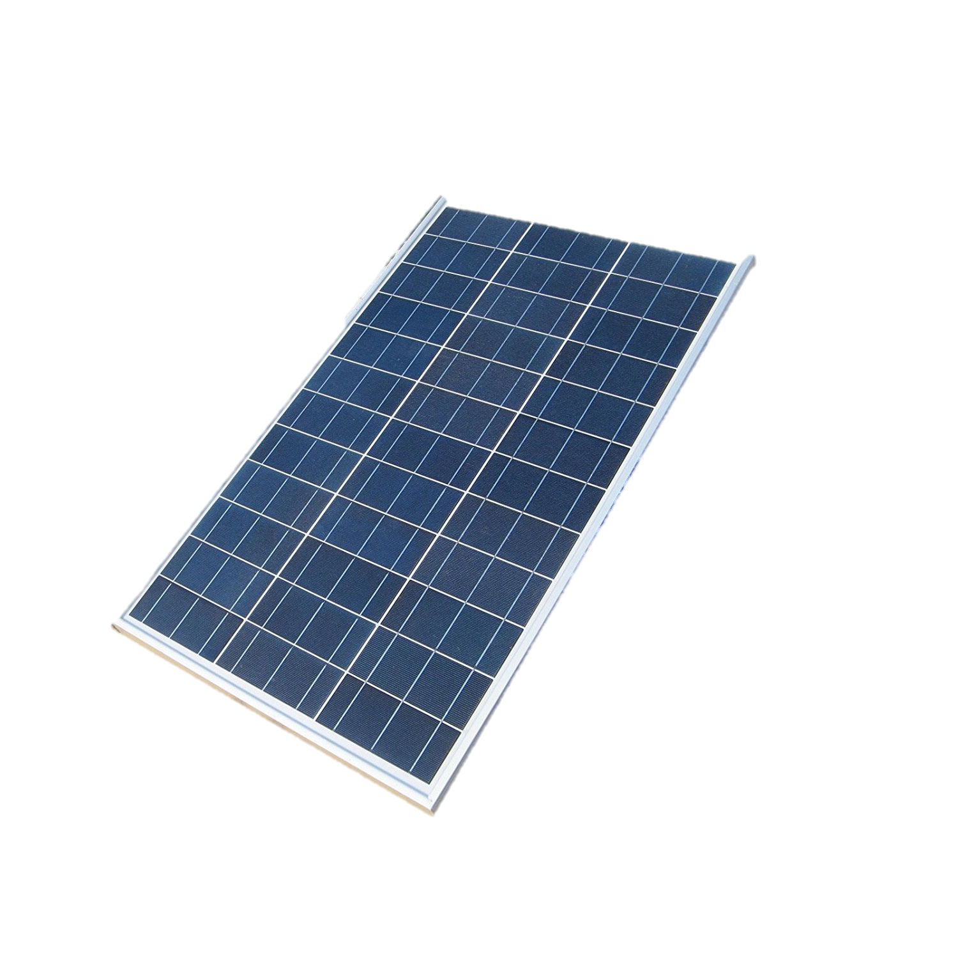
What is my project about?
How do we supply Europe with green energy?
How flexible is the solution to this problem?

Slide 2
What is my project about
MGA solutions
Modeling to generate alternatives (MGA)
MGA constraint
Cost
MGA slack
Optimal solution
Capacity of technology

Slide 3
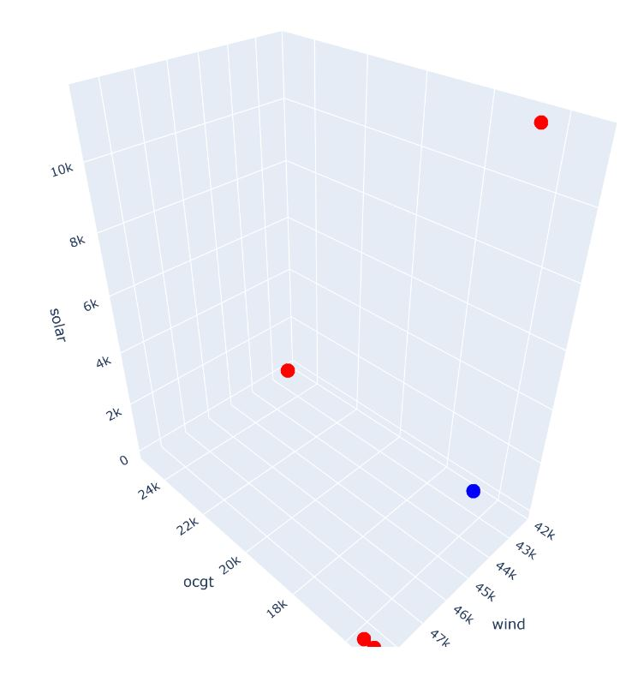
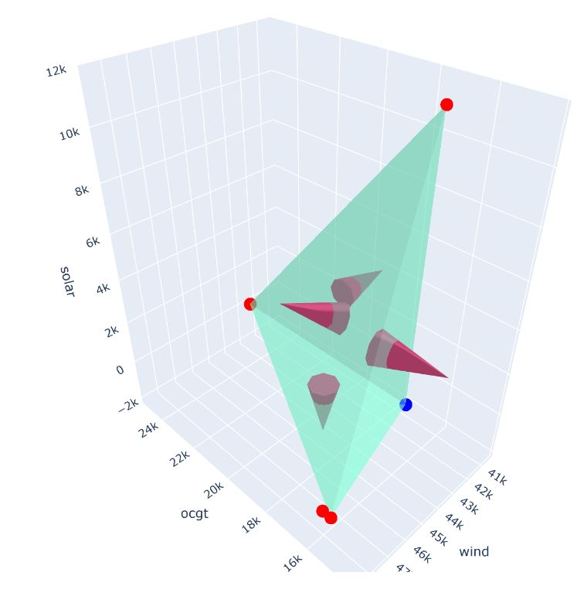
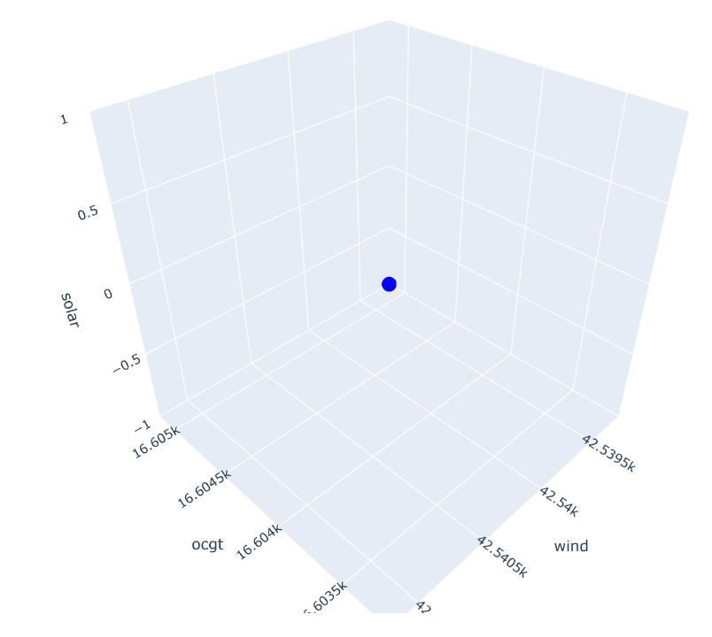
The big question!
How can all near optimal solutions be explored in a structured way?

Slide 4
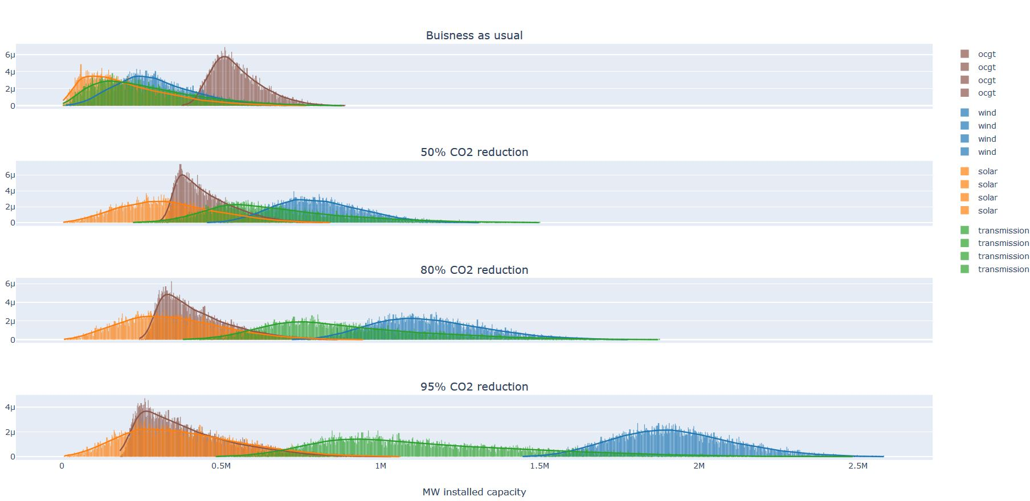
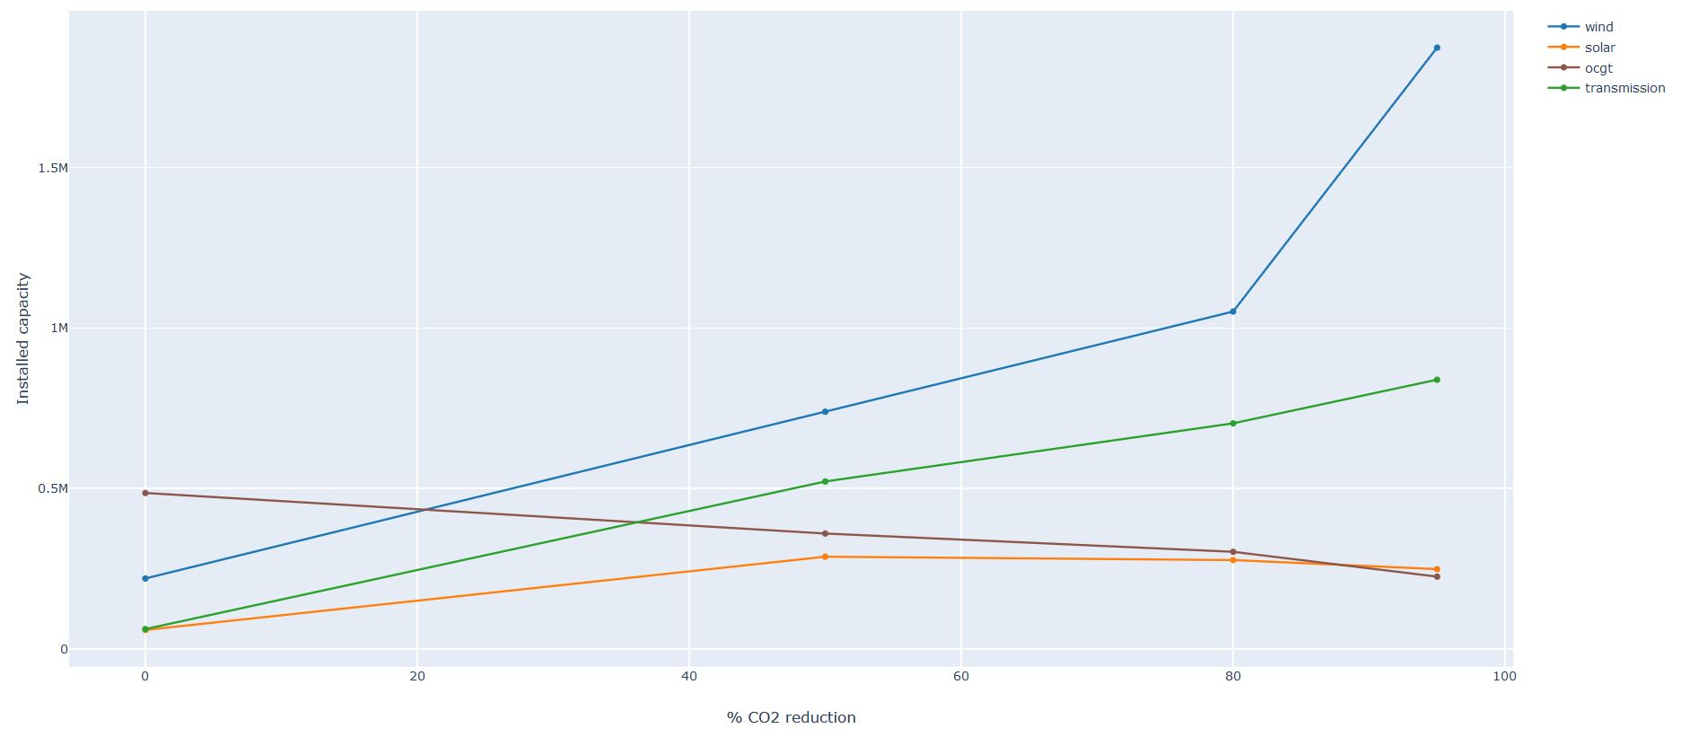
Results

Slide 5
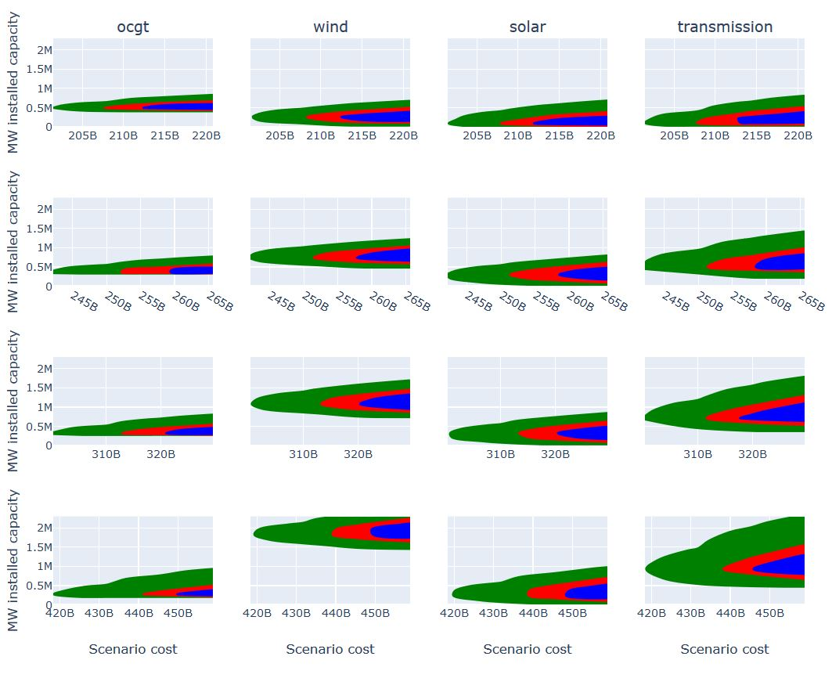




Results
More money = More flexibility

Slide 6
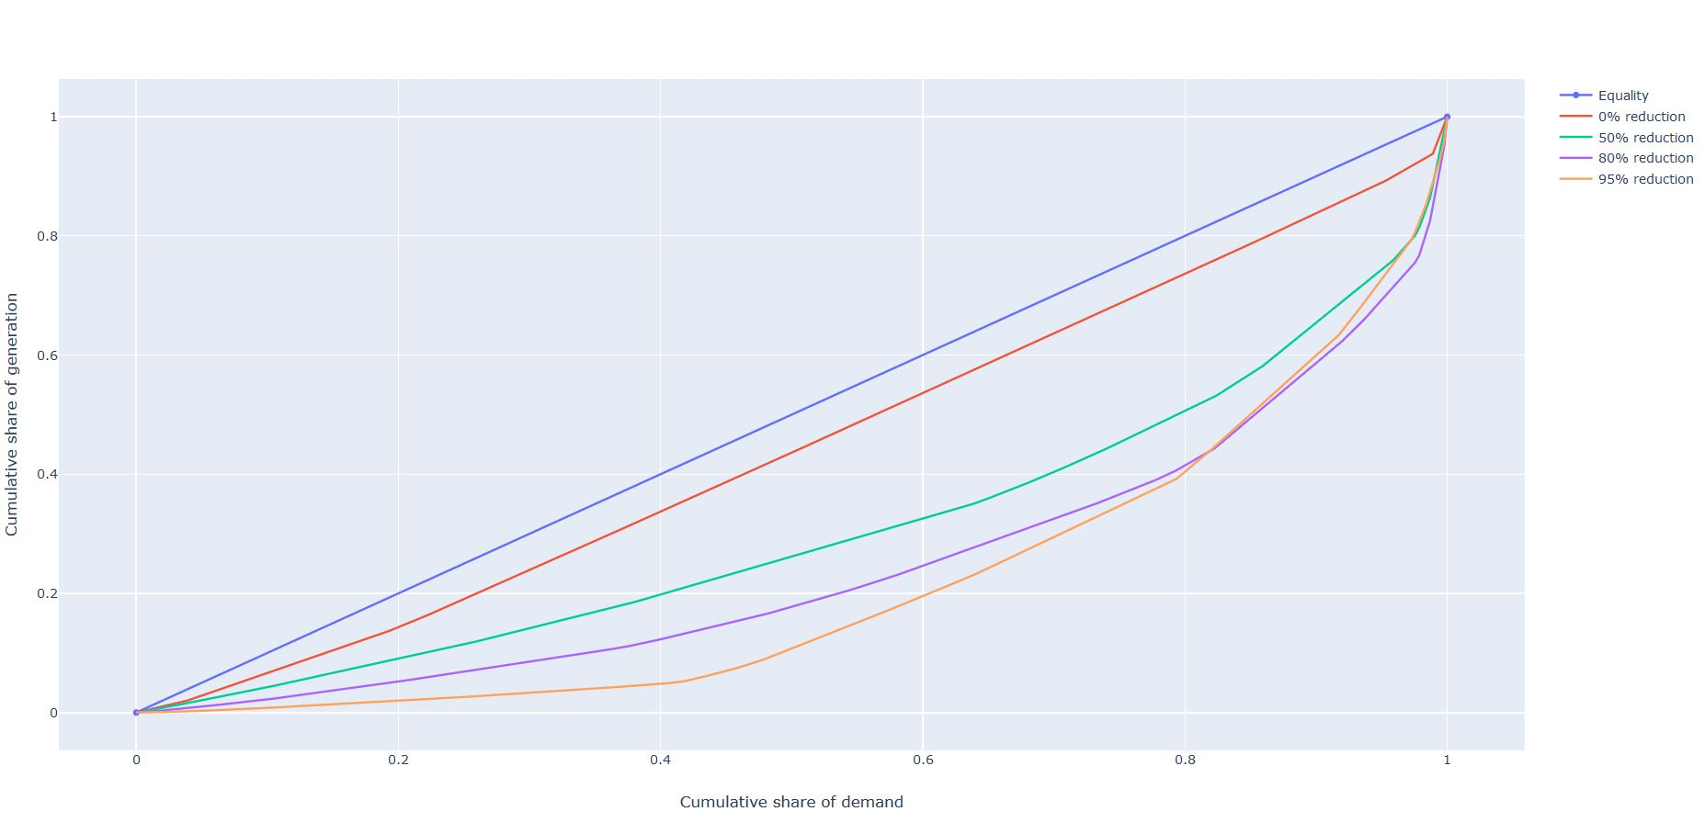
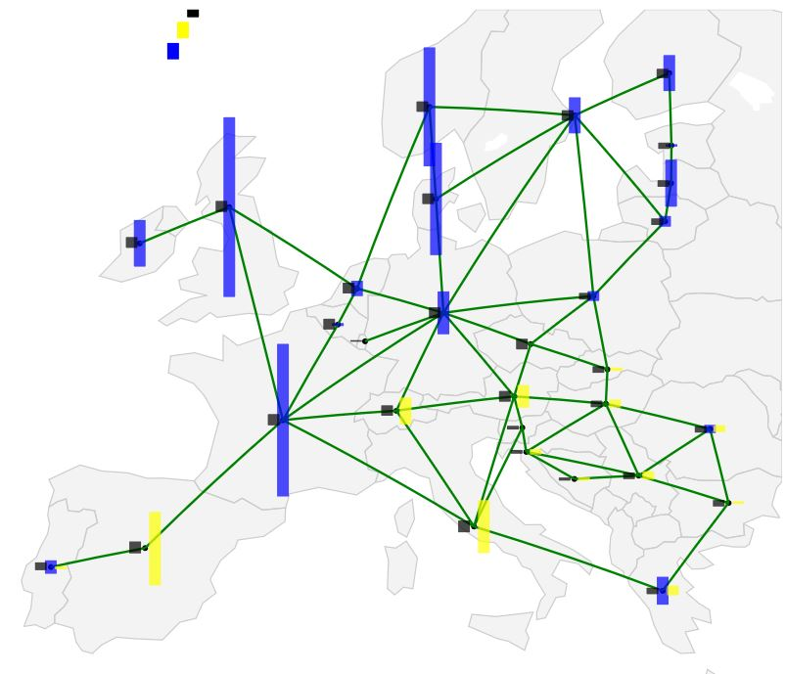
Results
More CO2 reduction = Larger inequality of generation/consumption per country

Slide 7
Conclusion
A structured method of exploring all near optimal solutions have been defined
This method is however limited by the dimensionality of the studies performed
Europe needs a lot of wind power

